Slide 1

Can’t wait to tell you about the movies
Ryan Coslove rmc326

Slide 2
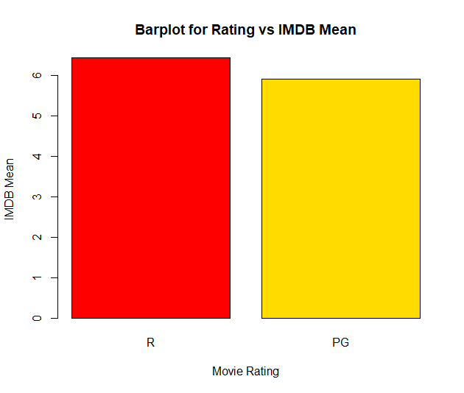
High Budget R movies have lower mean imdb scores than High Budget PG movies
The Null Hypothesis - High Budget R Movies have the same mean imdb scores as High Budget PG Movies
The Alternative Hypothesis – High Budget R movies have higher mean imdb scores than High Budget PG Movies
Without calculating p or z, we can see the IMDB means are not far apart or statistically significant, so we can likely reject the null and infer the alternative hypothesis is true.

Slide 3
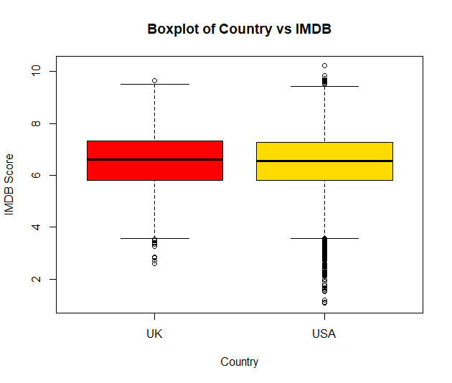
Movies in usa have lower imdb scores than movies In the UK
The Null Hypothesis – Movies in the USA have the same imdb scores as Movies in the UK
The Alternative Hypothesis – Movies in USA have higher imdb scores than movies In the UK
Without calculating p or z, we can see the IMDB scores are not far apart or statistically significant, so we can likely reject the null and infer the alternative hypothesis is true.

Slide 4
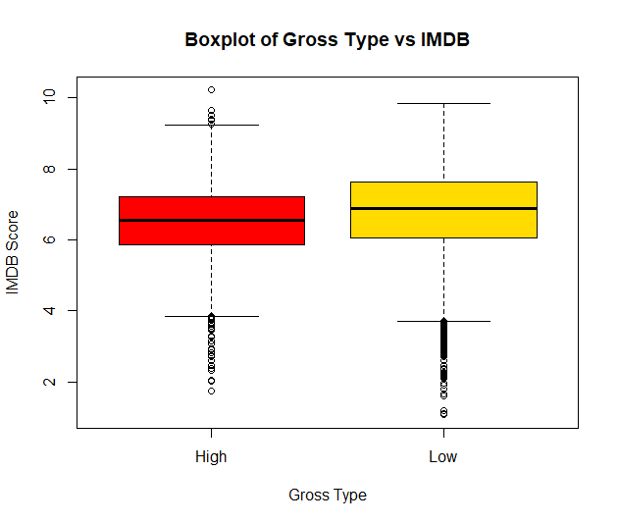
Movies that have a high gross have higher imdb scores than movies with a low gross
The Null Hypothesis – Movies that have a high gross have the same imdb scores than movies with a low gross
The Alternative Hypothesis – Movies that have a high gross have lower imdb scores than movies with a low gross
Without calculating p or z, we can see the IMDB scores are not far apart or statistically significant, so we can likely reject the null and infer the alternative hypothesis is true.

Slide 5
What did we learn?
We have learned through alternative hypothesis that High Budget R movies have higher mean IMDB scores than High Budget PG movies
We have learned through alternative hypothesis that Movies in USA have higher imdb scores than movies In the UK
We have learned through alternative hypothesis that Movies that have a high gross have lower imdb scores than movies with a low gross
None of the findings proved to be statistically significant, therefore we were able to reject the null and infer the alternative hypothesis to be true.

